Slide 1
CS 2600 Computer Networks I Dr. Sayeed Sajal Lecture 17 Sliding Window ARQ

Slide 2
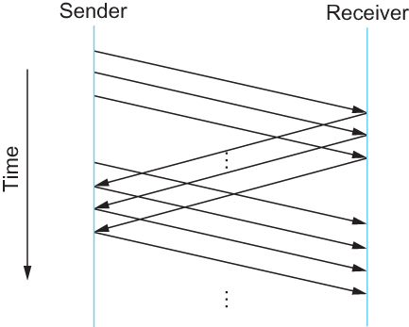
Figure 2.19 Timeline for the Sliding Window Algorithm
RTT

Slide 3
Example of a Sequence Number in HDLC
Increment by 1 for each new frame, ranging from 0 (000₂) to 7 (111₂) in HDLC.

Slide 4
Figure 2.20 Sliding Window on Sender
SeqNum - a frame number (must be one greater than the number of the previous frame)
SWS - Send Window Size (maximum number of unacknowledged frames that can be transmitted – a constant in Data-link protocols)
LAR - Last ACK Received (the SeqNum of the last frame that has been acknowledged by the receiver)
LFS - Last Frame Sent (sequence number of the last frame transmitted by the sender, ≤ largest frame number in current window)

Slide 5
Initial State of Sender’s Sliding Window
(continued on next slide)

Slide 6
Sliding Window After Two Frames Acknowledged and One Additional Frame Sent
Note that the window has advanced by two, and that one additional frame may be transmitted at this point without receiving any more ACKs.

Slide 7
Figure 2.21 Sliding Window on Receiver
RWS - Receive Window Size. Limits the range of frame numbers that the receiver will accept (in case some are lost). When RWS > 1, any out-of-order frames that reside within the window will be buffered (saved) until the missing frame is received.
LFR - Last Frame Received. The SeqNum of the last frame correctly received.
LAF - Largest Acceptable Frame. (Largest frame number, not frame size). This is the SeqNum of the last frame that the receiver will accept. Incoming frames with a SeqNum outside of the receive window will be discarded.
SeqNumToAck - Sequence Number to ACK. This is the SeqNum of the last frame received so far (LFR), implying that all frames with SeqNum less than or equal to SeqNumToAck have all been received correctly. This facilitates a cumulative ACK message. Some systems (e.g. HDLC) acknowledge “next frame expected” (SeqNumToAck + 1), rather than “last frame received”.

Slide 8
Receive Sliding Window Example (Based on text p. 108 – 109)
When a frame arrives, the receiving data-link protocol does a check. If LFR < SeqNum <= LAF, it is accepted. Otherwise, it is discarded as “outside of the receive window”.
Now the receiver must decide how to ACK that frame. The receiver will ACK using the SeqNumToAck, the highest SeqNum of the contiguous frames which it has received and not yet acknowledged. For example, assume that LFR = 5 (frames 1 - 5 have arrived), and that the RWS = 4, as shown below.
(cont.)

Slide 9
Receive Sliding Window Example Showing Missing Frame
If frames 7 and 8 arrive next, they can be buffered (stored in memory) because they lie within the invariant LFR < SeqNum <= LAF. In other words, they are “within the receive window”.
However, the cumulative ACK for frame 8 cannot be returned at this point (and SeqNumToAck and LFR will remain set to 5) because frame 6 has not yet been correctly received. For the same reason, the receive window does not advance.
(cont.)

Slide 10
Receive Sliding Window Example Showing Recovery From Missing Frame
Eventually the sender’s T1 timer expires (or the receiver NAKs frame 6), and 6 is retransmitted. When frame 6 is received, SeqNumToAck will be set to 8, the new LAF will become 12, a cumulative ACK for frame 8 will be returned to the sender, and LFR will be set to 8. The receive window is then advanced beyond the LFR.

Slide 11
HDLC Supervisory Frame Types for Go-Back-n and Selective Reject

Slide 12
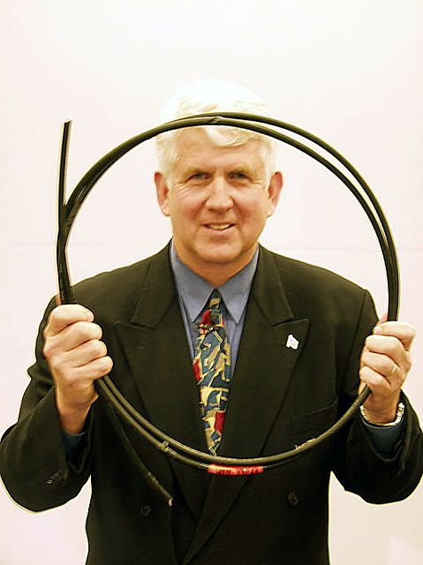
Bob Metcalfe (1946 - )
Inventor of Ethernet (with David Boggs)
Recipient of the National Medal of Technology, awarded by President George W. Bush in 2005 for “the invention, standardization and commercialization of Ethernet”
Metcalfe’s Law: “The value of a communications network is proportional to the square of the number of connected users of the system (n²).”

Slide 13
Parsing “CSMA/CD” and “10BASE5”
Carrier Sense Multiple Access with Collision Detect
Listen for other nodes’ transmissions…
…sense when multiple messages cross on the wire
…allow multiple nodes to share the cable …
10BASE5
Mbps
cable segment
length (x100 meters)
baseband
(digital)

Slide 14
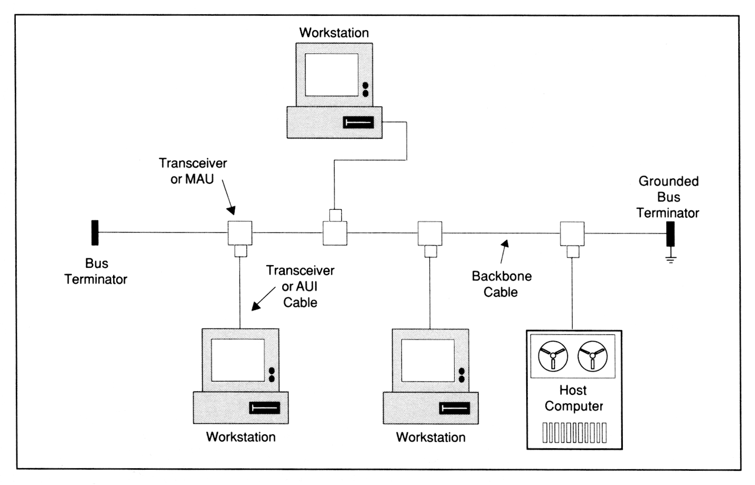
IEEE 802.3 10BASE 5 (Thick Ethernet) Topology
(the “Bus”)
From LAN Troubleshooting Handbook, 2nd Ed. by M. Miller (M & T Books)

Slide 15

Ethernet Animation: Normal Transmission*
This demonstrates a normal Ethernet frame transmission, where no collision occurs.
*Click the image to run the animation in your browser
http://www.datacottage.com/nch/eoperation.htm has a series of Ethernet animations along with a good introductory-level Ethernet tutorial.
http://www.datacottage.com/nch/eoperation.htm#.Um2CghDhL8o

